Slide 1

Financial Marketing Prediction
PRESENTED BY GROUP 8
Jazbi Izhar
Chirag Ashokkumar Bhatia
Kevin Xavier Antony Arul Xavier
Vikas Baliyan
Ramuel John Batuigas
Bharat Sharma
Sidhartha Sankar Mondal

Slide 2
TABLE OF CONTENTS – STEP WISE PROCESS
Data understanding
Data cleaning and processing
Evaluation Metric used to Evaluate model
Classification Model – Logistic, Decision Trees, Random Forest, SGD, SVM
Model Summary
Data Acquisition
UCI machine learning
Samples: 4133
Variables: 16
Bank Marketing Weather a customer is taking a term deposit or not
VARAIBLES
Age, Job, Marital, education, bank balance and ...

Slide 3
DATA AND PROJECT UNDERSTANDING - 1
GLIMPSE OF DATA
age | job | marital | education | default | balance | housing | loan | contact | day | month | duration | campaign | pdays | previous | poutcome | y
33 | admin. | single | tertiary | no | 272 | yes | no | cellular | 1 | sep | 293 | 2 | 92 | 3 | success | yes
29 | admin. | married | secondary | no | 6429 | yes | yes | cellular | 14 | may | 535 | 1 | 352 | 2 | failure | no
62 | retired | married | primary | no | 1742 | no | no | cellular | 14 | jun | 167 | 2 | 98 | 6 | other | yes
62 | retired | married | primary | no | 3738 | no | no | telephone | 10 | aug | 151 | 3 | 185 | 1 | failure | no
In this project we study different approaches to predict the success of bank telemarketing. As instrument we have a dataset related with direct marketing campaigns based on phone calls of a Portuguese banking institution. Often, more than one contact to the same client was required, in order to access if the product (bank term deposit) would be (yes) or not (no) subscribed.
The dataset is having 18 variable out of which 17 columns are Independent and one column y is dependent column

Slide 4
DATA AND PROJECT UNDERSTANDING - 1
Feature | Feature Meaning | Feature Type | Value Range
age | Identifies the age of the customer | Numeric | 18-90
job | Identifies the job of the customer | Categorical | "admin.","unknown","unemployed","management","housemaid","entrepreneur"
marital | Identifies the marital status of the customer | Categorical | "married","divorced","single"
education | Identifies the education of the customer | Categorical | "unknown","secondary","primary","tertiary"
default | Identifies whether the customer credit is in default stage or not | Binary | "yes","no"
balance | Identifies the bank balance of the customer | Numeric
housing | Identifies whether customer is having a housing loan or not | Binary | "yes","no"
loan | Identifies he customer is having the personal loan or not | Binary | "yes","no"
contact | Identifies the contact number of the customer | Categorical | "unknown","telephone","cellular"
day | Identifies the day on which the customer was contacted | Numeric
month | Identifies the month in which the customer was contacted | Categorical | "jan", "feb", "mar", ..., "nov", "dec"
duration | Identifies the duration since the customer was contacted | Numeric | "unknown","other","failure","success"
campaign | Identifies which number campaign they were contacted | Numeric
pdays | number of days that passed by after the client was last contacted from a previous campaign | Numeric
previous | number of contacts performed before this campaign and for this client | Numeric
poutcome | outcome of the previous marketing campaign | Categorical
y | the client subscribed a term deposit | binary | "yes","no"

Slide 5
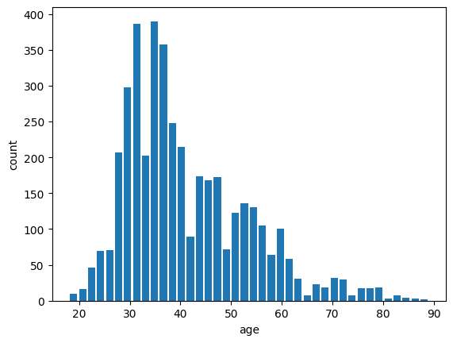
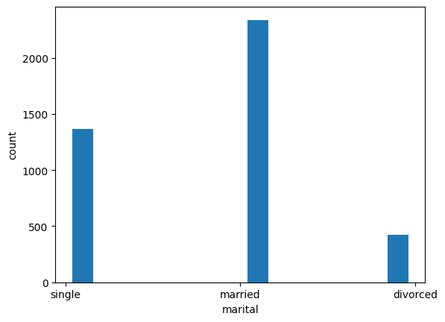
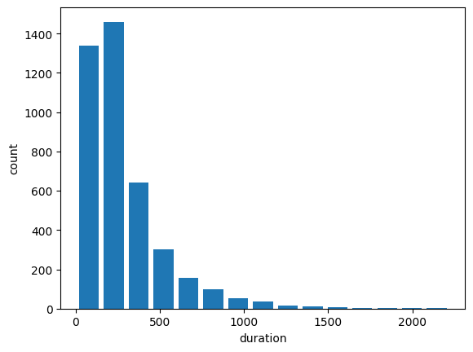
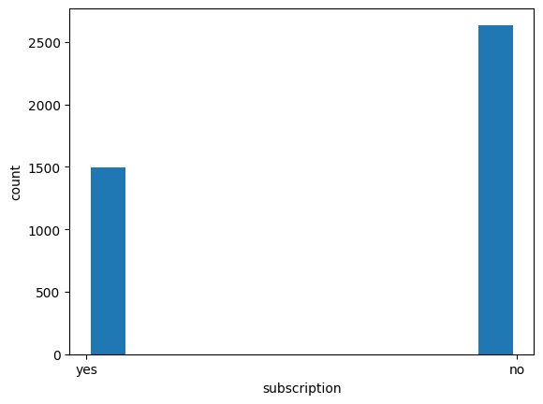
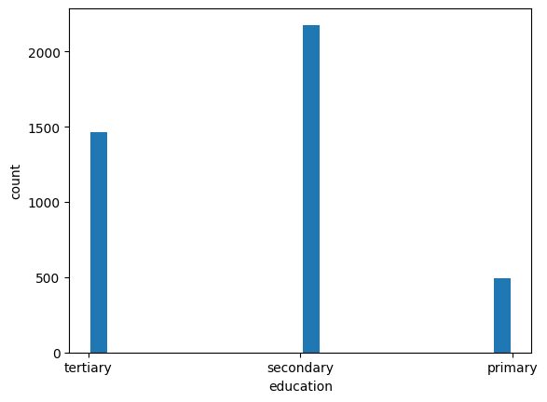
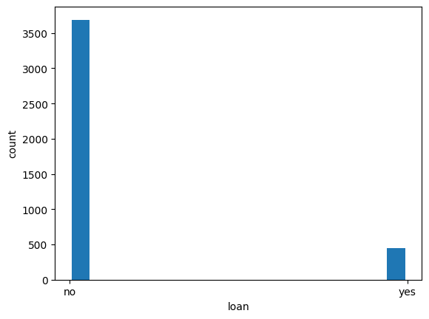
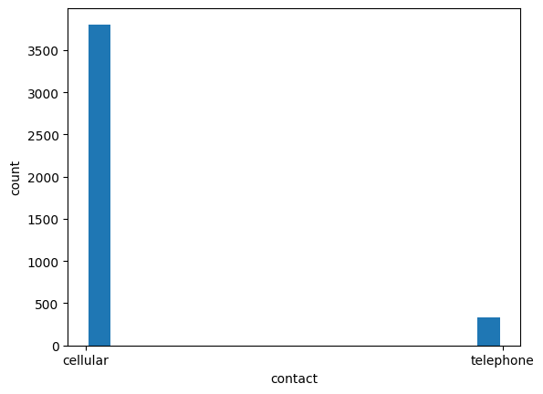
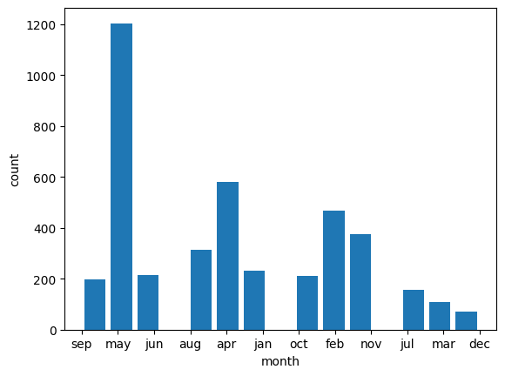
HISTOGRAM OF ALL CATEGORICAL VARIABLES

Slide 6
DATA CLEANING AND NEXT STEPS
1
2
Label Encoded the categorical variable
Z score normalisation of numeric columns
3
4
Binning of Age group for interpretation
Train Test Split the Data with 80-20 split
5
6
Used feature Selection on Train data
Model Fitting and result comparison
In Model building we first built a base model with all feature then used Recursive Feature Elimination technique to keep the best ones and fitted the model with tuned parameters. The models are compared on the basis of Accuracy, precision and Recall.

Slide 7
Logistic Regression
Model with Tuned Parameters gives the best prediction with 0.810 accuracy, 0.08 better than the base model.
Base Model
Model with Selected feature
Model with Tuned Parameters
 |  | Actual
 |  | Yes | No
Predicted | Yes | 465 | 61
 | No | 103 | 198
 |  | Actual
 |  | Yes | No
Predicted | Yes | 466 | 60
 | No | 124 | 177
 |  | Actual
 |  | Yes | No
Predicted | Yes | 465 | 61
 | No | 103 | 198
Accuracy | Precision | Recall
0.802 | 0.764 | 0.658
Accuracy | Precision | Recall
0.778 | 0.747 | 0.588
Accuracy | Precision | Recall
0.810 | 0.770 | 0.681
Features: housing, loan, contact, duration, poutcome
C =100,
penalty = l2,
Solver = ‘liblinear’

Slide 8
Decision Tree
Model tuned with parameters with selected features gave the best accuracy of 81.7%
Base Model
Model with Selected feature
Model with Tuned Parameters
 |  | Actual
 |  | Yes | No
Predicted | Yes | 425 | 101
 | No | 121 | 180
 |  | Actual
 |  | Yes | No
Predicted | Yes | 448 | 78
 | No | 110 | 191
 |  | Actual
 |  | Yes | No
Predicted | Yes | 462 | 64
 | No | 87 | 214
Accuracy | Precision | Recall
0.731 | 0.641 | 0.598
Accuracy | Precision | Recall
0.772 | 0.710 | 0.634
Accuracy | Precision | Recall
0.817 | 0.769 | 0.710
Balance, Day, Month, Duration, Pdays, Poutcome
min_samples_leaf = 5
max_depth = 5
criterion = entropy

Slide 9
Random Forest
Model with Tuned Parameters produced the best prediction model with 0.830 accuracy, 0.03 better than base model.
Base Model
Model with Selected feature
Model with Tuned Parameters
 |  | Actual
 |  | Yes | No
Predicted | Yes | 465 | 61
 | No | 82 | 219
 |  | Actual
 |  | Yes | No
Predicted | Yes | 459 | 67
 | No | 87 | 214
 |  | Actual
 |  | Yes | No
Predicted | Yes | 466 | 60
 | No | 81 | 220
Accuracy | Precision | Recall
0.827 | 0.782 | 0.728
Accuracy | Precision | Recall
0.817 | 0.766 | 0.717
Accuracy | Precision | Recall
0.830 | 0.786 | 0.731
Default model
Selected features: balance, day, month, duration, pdays, poutcome
n_estimators = 50, min_samples_split = 2,
min_samples_leaf = 4,
max_features = auto, max_depth = 90,
bootstrap = false

Slide 10
stochastic gradient descent
Model with tuned parameters & selected features has the better accuracy of 80.4% than the base model with 76.4%
Base Model
Model with Selected feature
Model with Tuned Parameters
 |  | Actual
 |  | Yes | No
Predicted | Yes | 486 | 40
 | No | 155 | 146
 |  | Actual
 |  | Yes | No
Predicted | Yes | 442 | 84
 | No | 86 | 215
 |  | Actual
 |  | Yes | No
Predicted | Yes | 441 | 85
 | No | 77 | 224
Accuracy | Precision | Recall
0.764 | 0.784 | 0.485
Accuracy | Precision | Recall
0.794 | 0.719 | 0.714
Accuracy | Precision | Recall
0.804 | 0.725 | 0.744
age, education, default, housing, loan, contact, duration, poutcome
penalty: L2, loss: modified_huber, learning_rate: invscaling, eta0: 1, alpha: 0.001

Slide 11
NEED TO COMPLETE
Support Vector Machine
Base Model
Model with Selected feature
Model with Tuned Parameters
 |  | Actual
 |  | Yes | No
Predicted | Yes
 | No
 |  | Actual
 |  | Yes | No
Predicted | Yes
 | No
 |  | Actual
 |  | Yes | No
Predicted | Yes
 | No
Accuracy | Precision | Recall
Accuracy | Precision | Recall
Accuracy | Precision | Recall

Slide 12
Top features FROM ALL THE MODELs
NEED TO COMPLETE
Feature | Logistic Regression | Decision Tree | Random Forest | SGD | SVM
age
job
marital
education
default
balance |  |  | True
housing | True
loan | True
contact | True
day
month |  |  | True
duration | True |  | True
campaign
pdays |  |  | True
previous
poutcome | True |  | True
y

